Slide 1
2021-2022
Scholarship and Awards

Slide 2
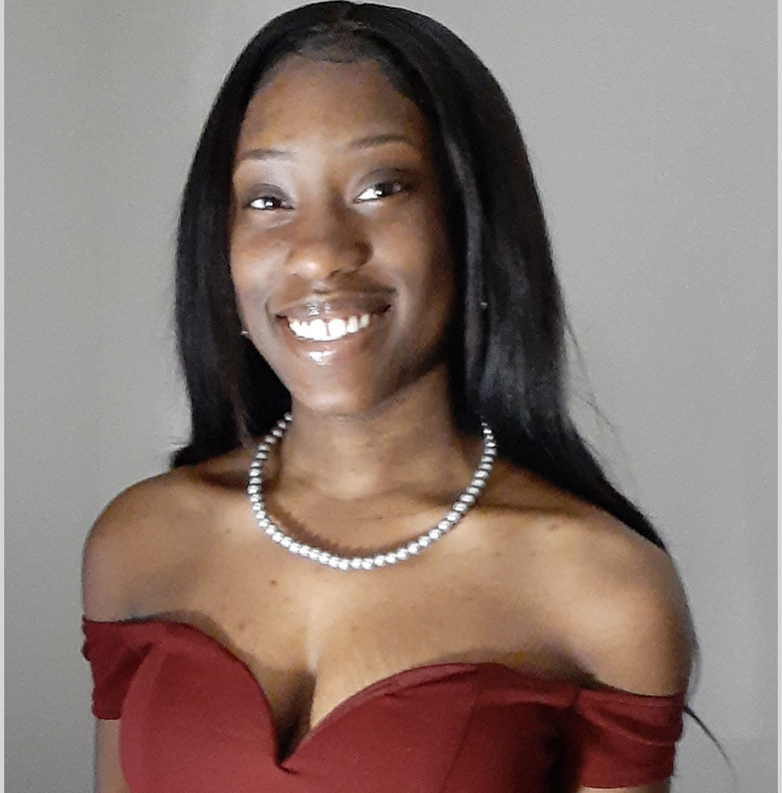
Khari Garvin Scholarship
Alania Mariah Cherry
Greene Lamp, Inc.

Slide 3
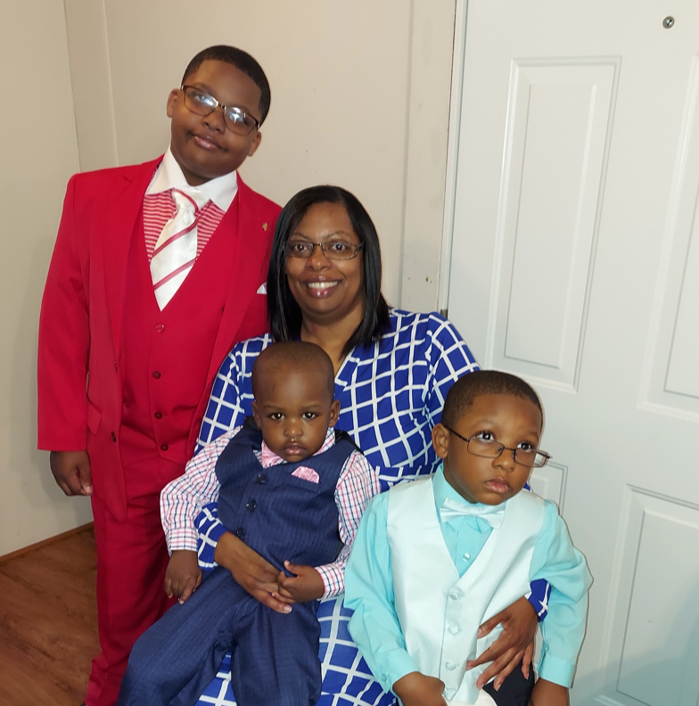
Parent of the Year
Charmaine McNeil
Greene Lamp, Inc.

Slide 4
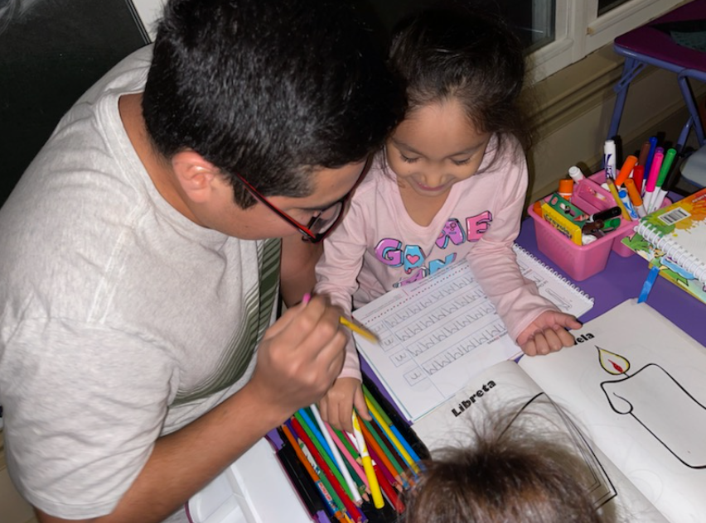
Father of the Year
Armando Martinez- Rosales
Greene Lamp, Inc.

Slide 5
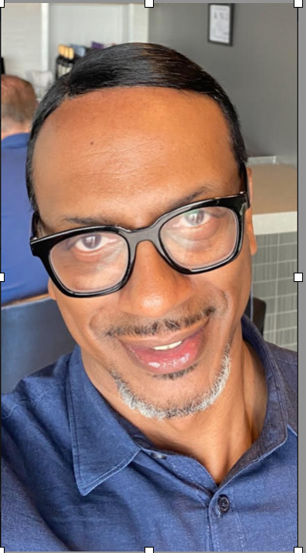
Staff of the Year
Anthony Johnson
Families and Communities Rising, Inc.

Slide 6
Support Staff of the Year Nominees

Slide 7
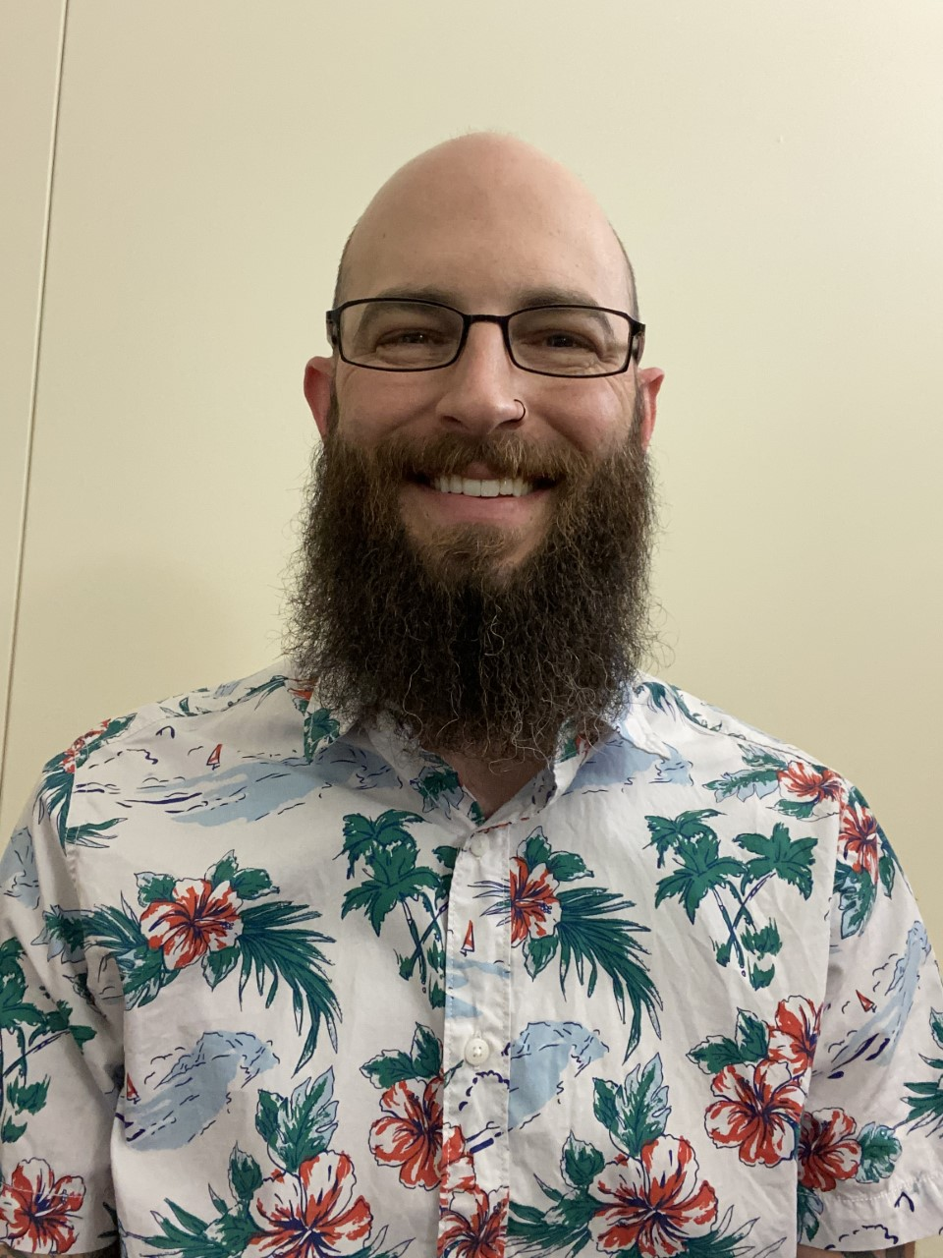
Christian Ryan
Family Services, Inc.

Slide 8
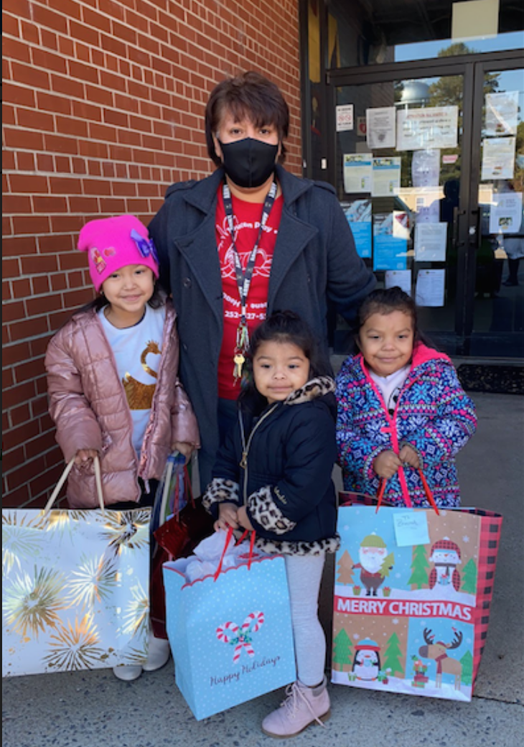
Lourdes Villgran
Greene Lamp Inc.

Slide 9
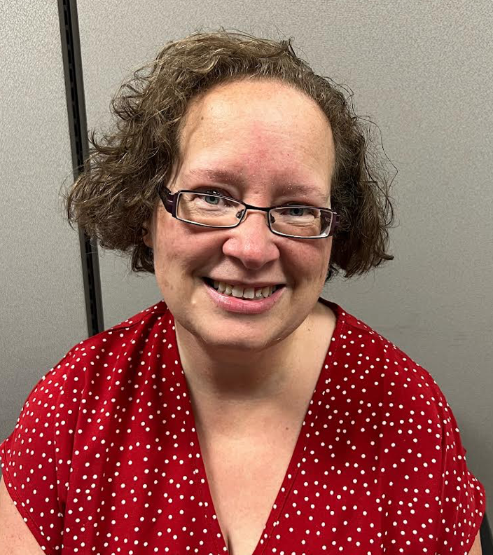
Amy Woodsong
Families and Communities Rising, Inc.

Slide 10
Support Staff of the Year
Christian Ryan
Family Services, Inc.

Slide 11
The Patricia Beier
Family Advocate of the Year
Nominees

Slide 12
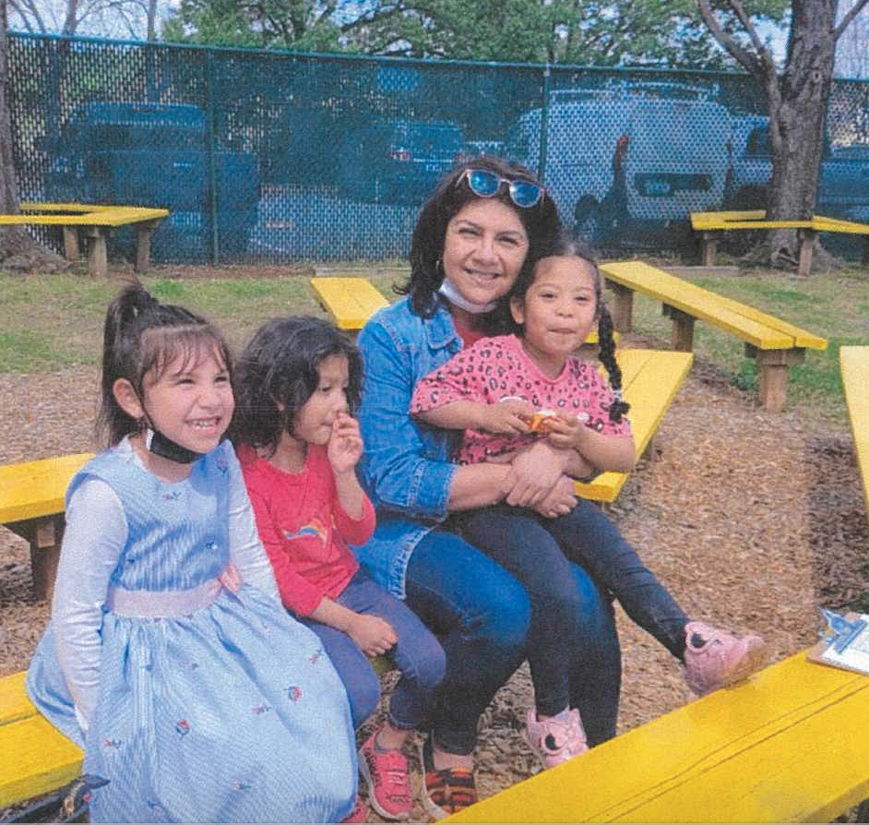
Maria Cardenas
Alliance Center for Education

Slide 13
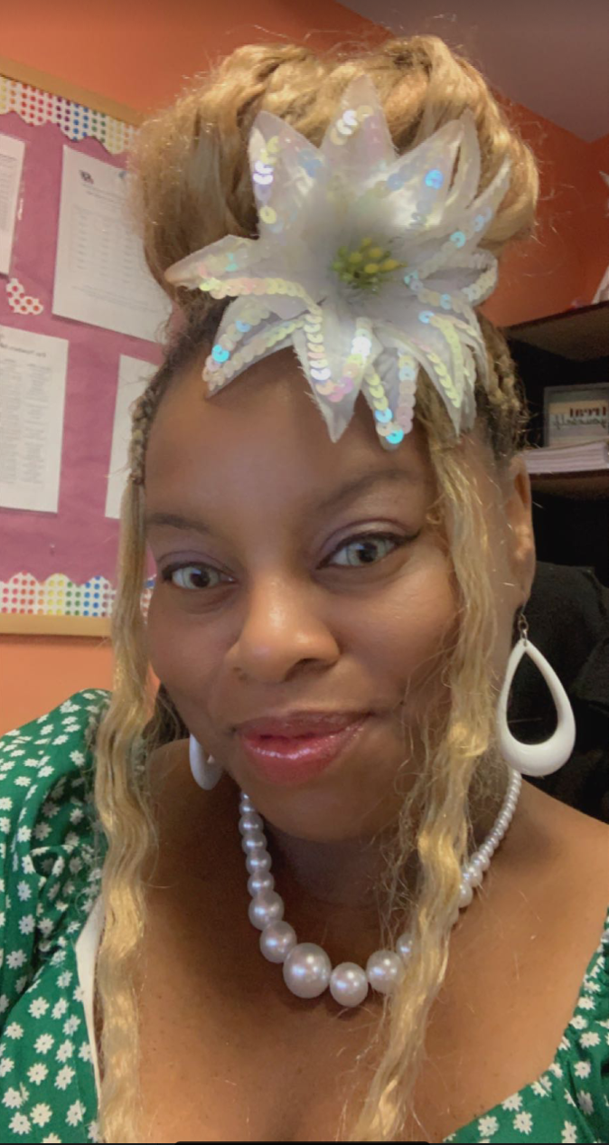
Princella Lewis
ICARE

Slide 14
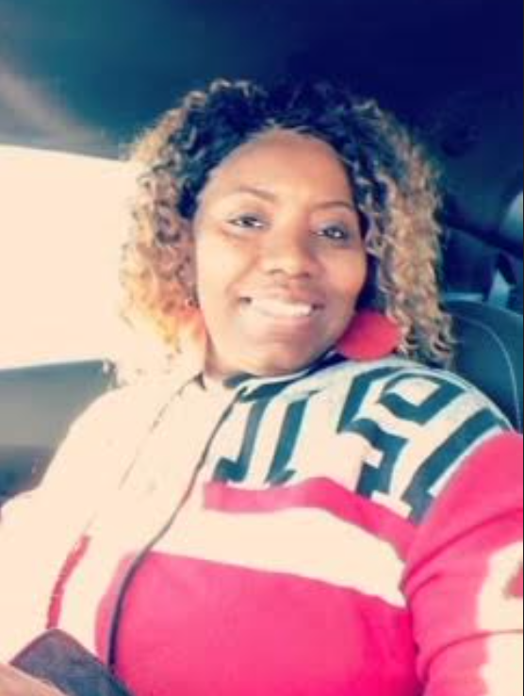
Shartarka Carmon
Families and Communities Rising, Inc.

Slide 15
Family Advocate of the Year
Princella Lewis
ICARE

Slide 16
Teacher Assistant of the Year Nominees

Slide 17
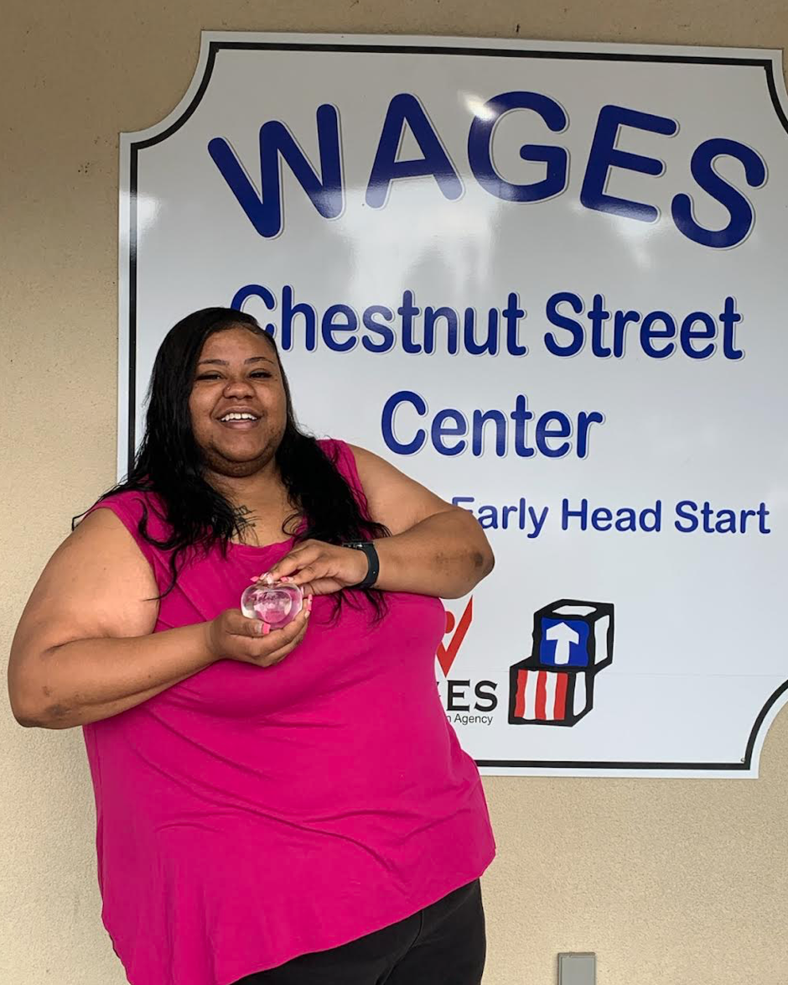
Deneisha Banks
WAGES

Slide 18
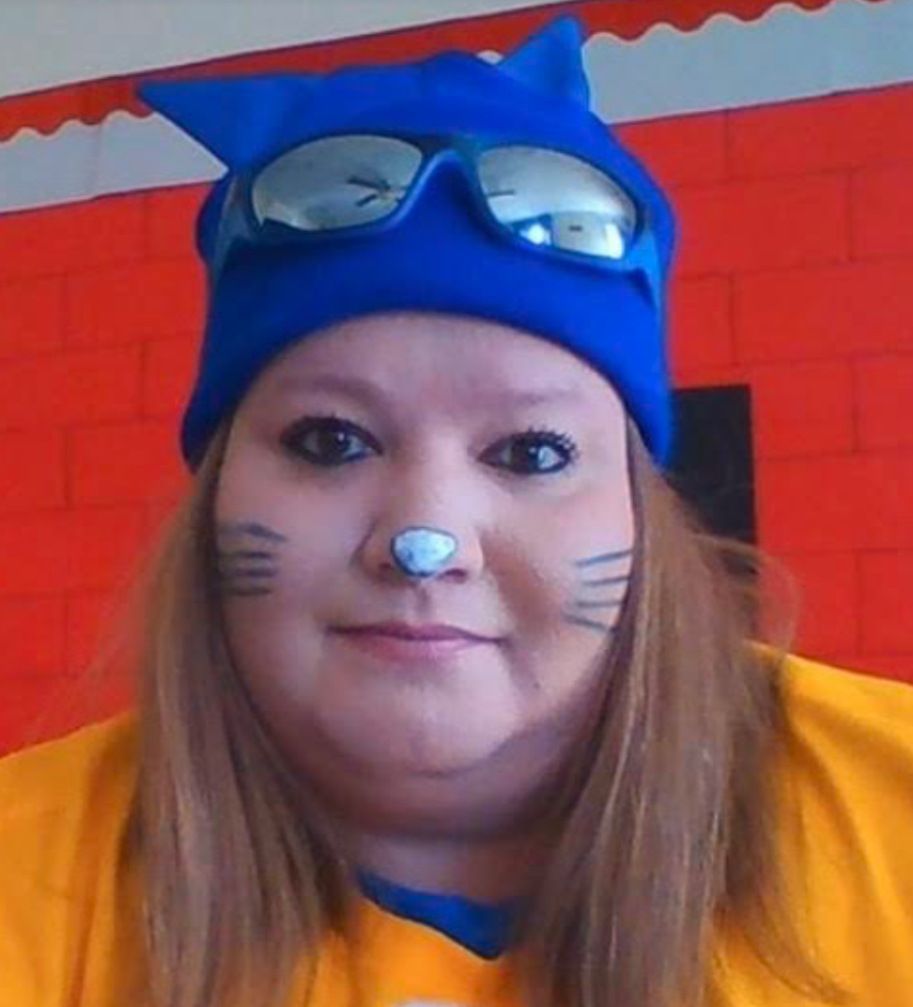
Stephanie Stark
Greene Lamp, Inc.

Slide 19
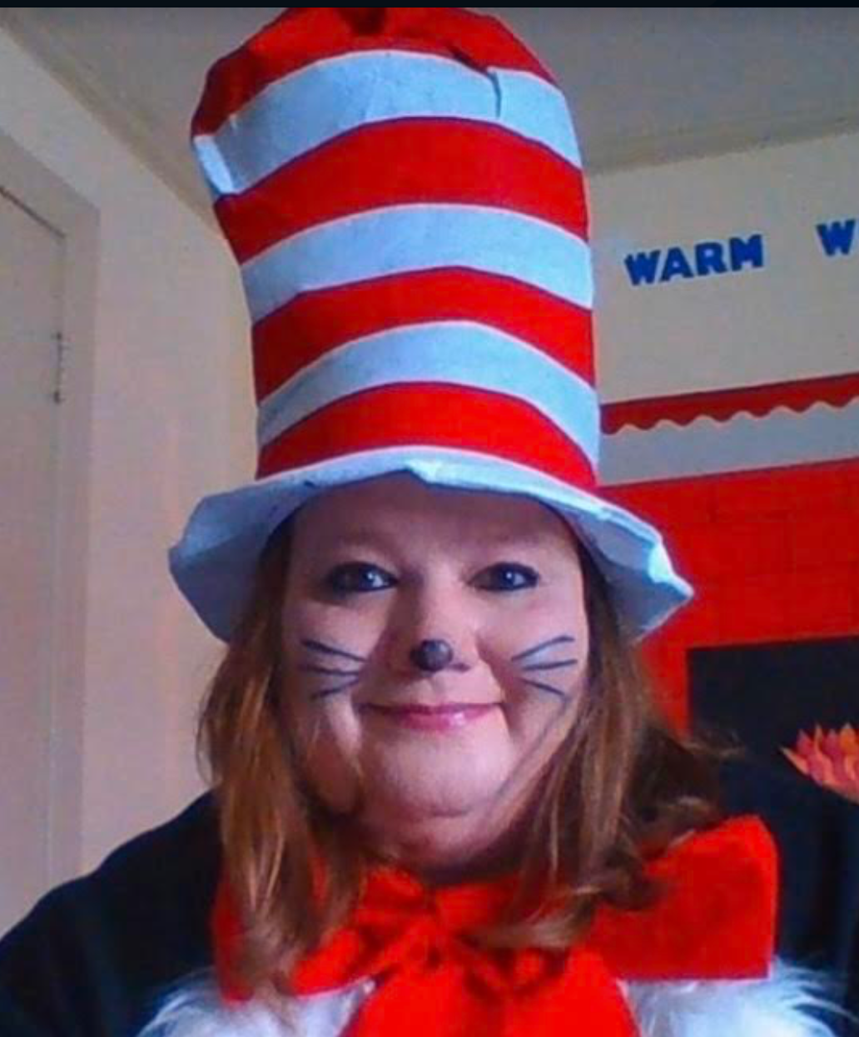
Teacher Assistant of the Year
Stephanie Stark
Greene Lamp, Inc.

Slide 20
Teacher of the Year Nominees

Slide 21
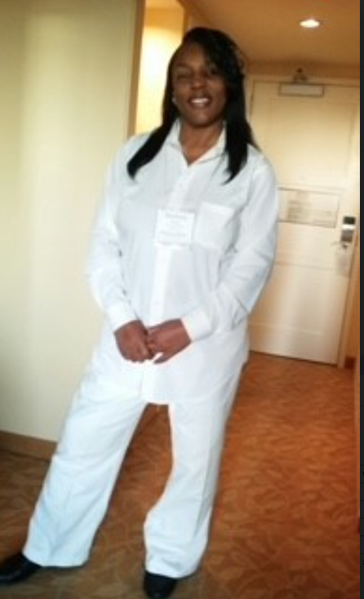
Darlene Bryant
Greene Lamp, Inc.

Slide 22
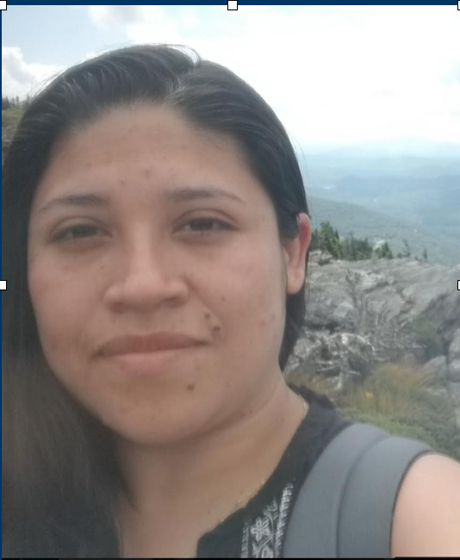
Abigail Cruz
Families and Communities Rising, Inc.

Slide 23
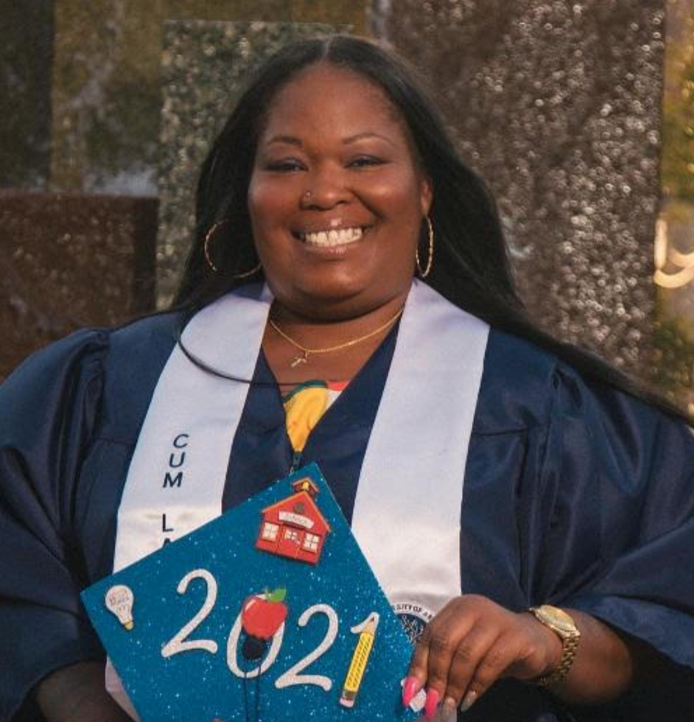
LaShonda Lewis
WAGES

Slide 24
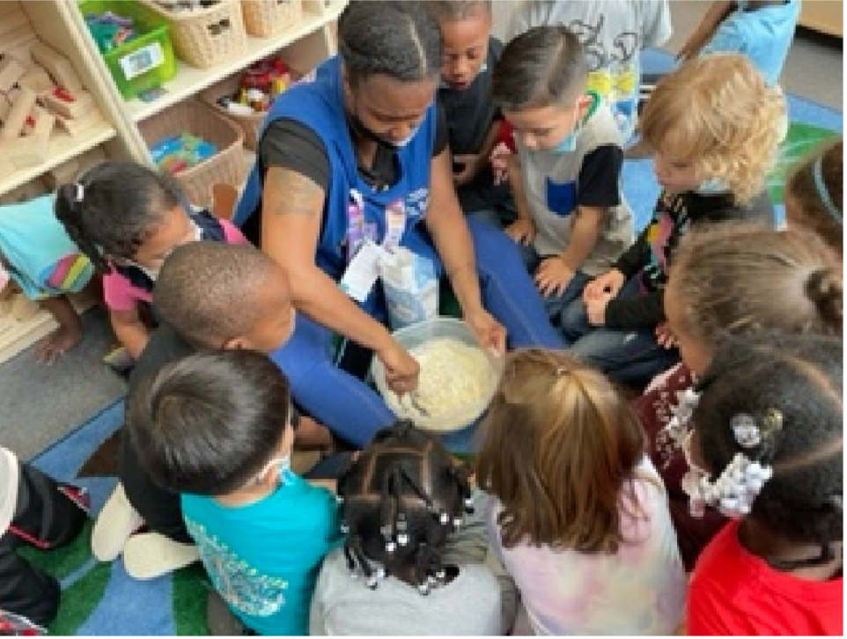
Natasha Robinson
Telamon

Slide 25
Teacher of the Year
Darlene Bryant
Greene Lamp. Inc.

